Slide 1
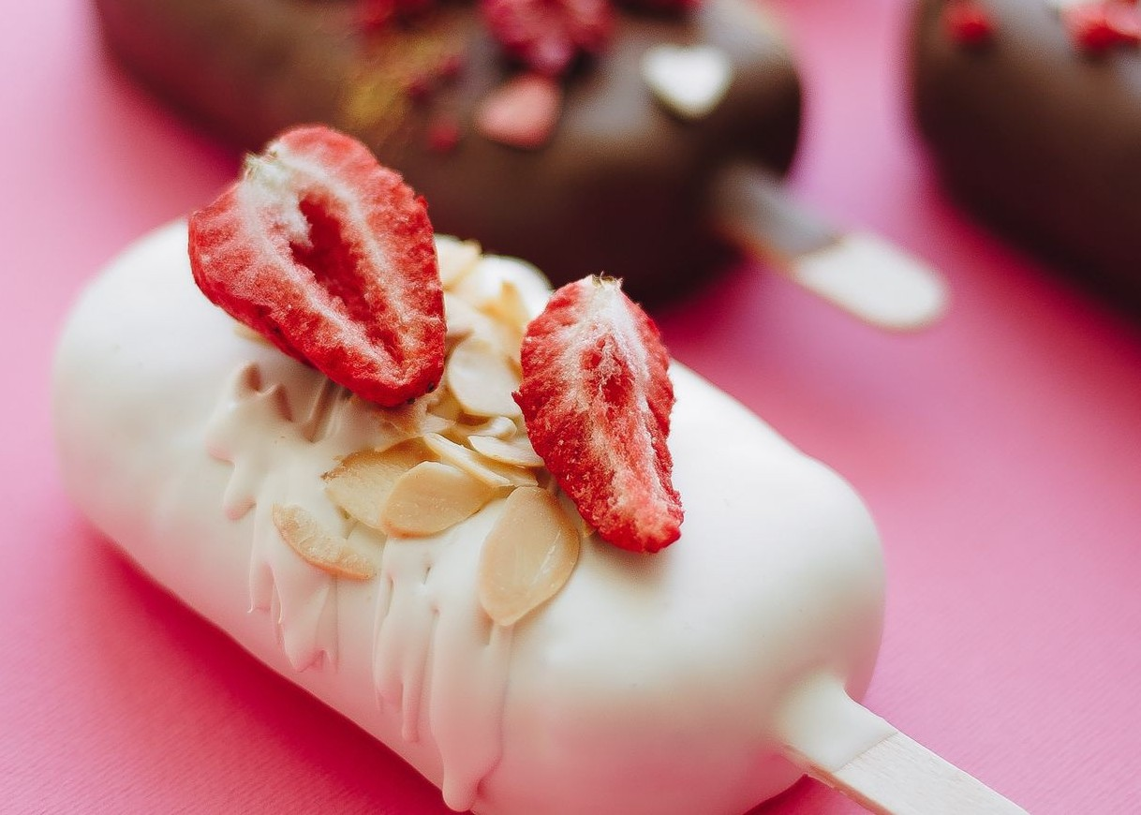
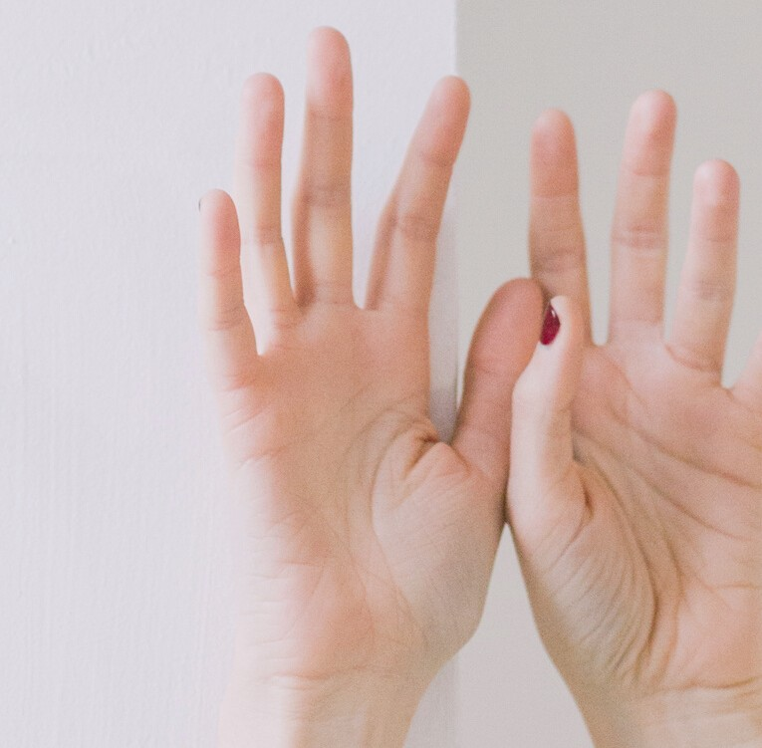
Say hello to
your own dessert web application page!
Microservices Part B project by Plamena Petkova
Notes:
Hello everyone, I am excited to start first and show you my Microservices part B project based on dessert/food web application page .

Slide 2
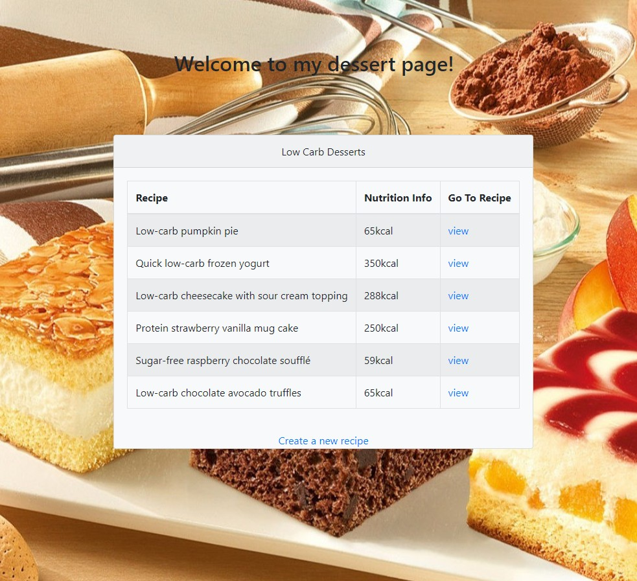
p
o
r
u
s
e
P
LOW CARBOHYDRATE DESSERT RECIPE
WEB APPLICATION WHERE EVERY
PERSON
REGARDLESS OF
RACE, GENDER, AGE, ETHNICITY OR
RELIGION CAN USE FOR PERSONAL
INTEREST.
Notes:
The purpose of this web application (or a pruduct) is where every person regardless of race, gender, age, ethnicity or religion can use by storing recipes, adding new once or simply just editing them.

Slide 3
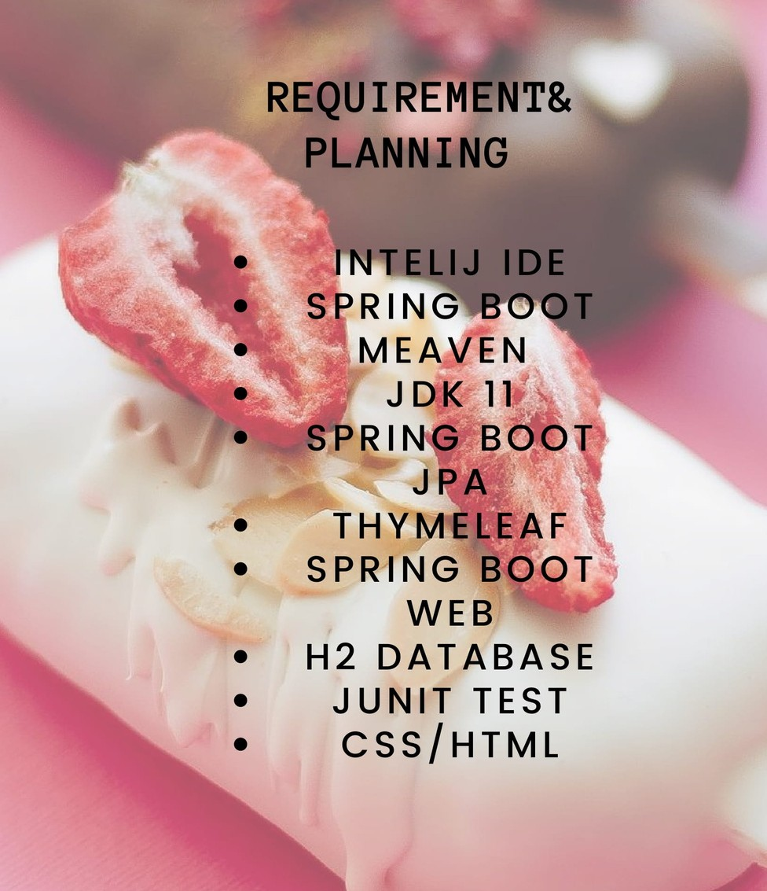
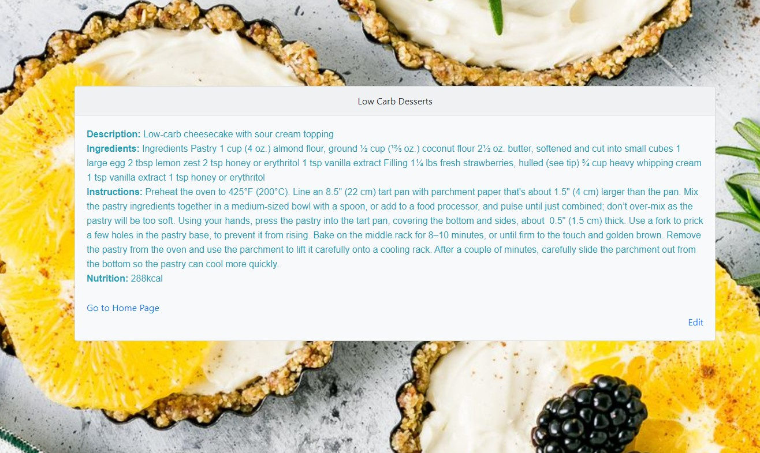
Let me take you through the web application pages
HOW I STARTED MY PROJECT?
Notes:
How I started my project and what technologies have been used?
This project has been started by creating a Meaven spring boot project with different dependencies. Such as H2 database that store all information from user’s web application, Thymeleaf, CSS, HTML for some enjoyable look of the pages in the application.

Slide 4
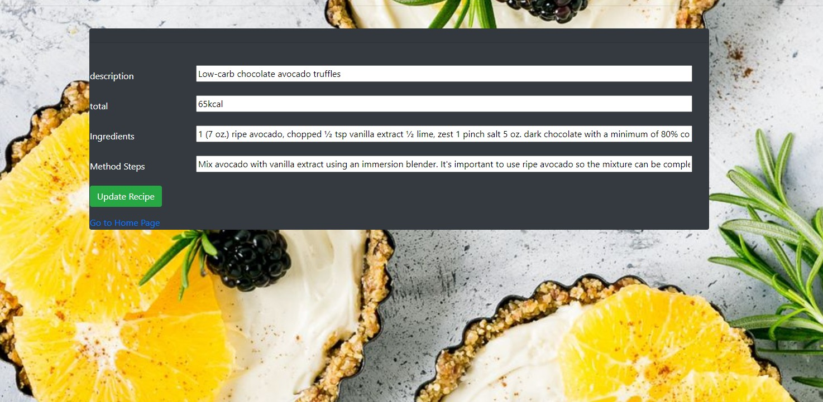
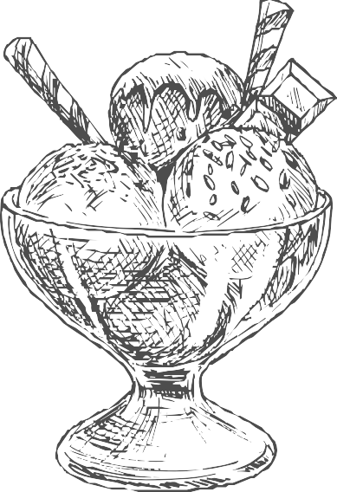

DESCRIPTION
TOTAL KILOCALORIES
INGREDIENTS
METHOD STEPS
TOTAL KILOCALORIES
UPDATE RECIPE
GO TO BACK HOME PAGE
Second page where you can update your
own recipe
Notes:
Second page of the product is where the user can update the information inside a table with some variables that I’ve used such as the following: strings such as description, method steps and total calories.

Slide 5
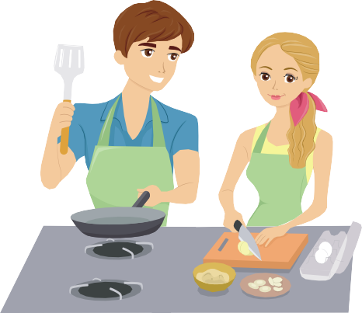

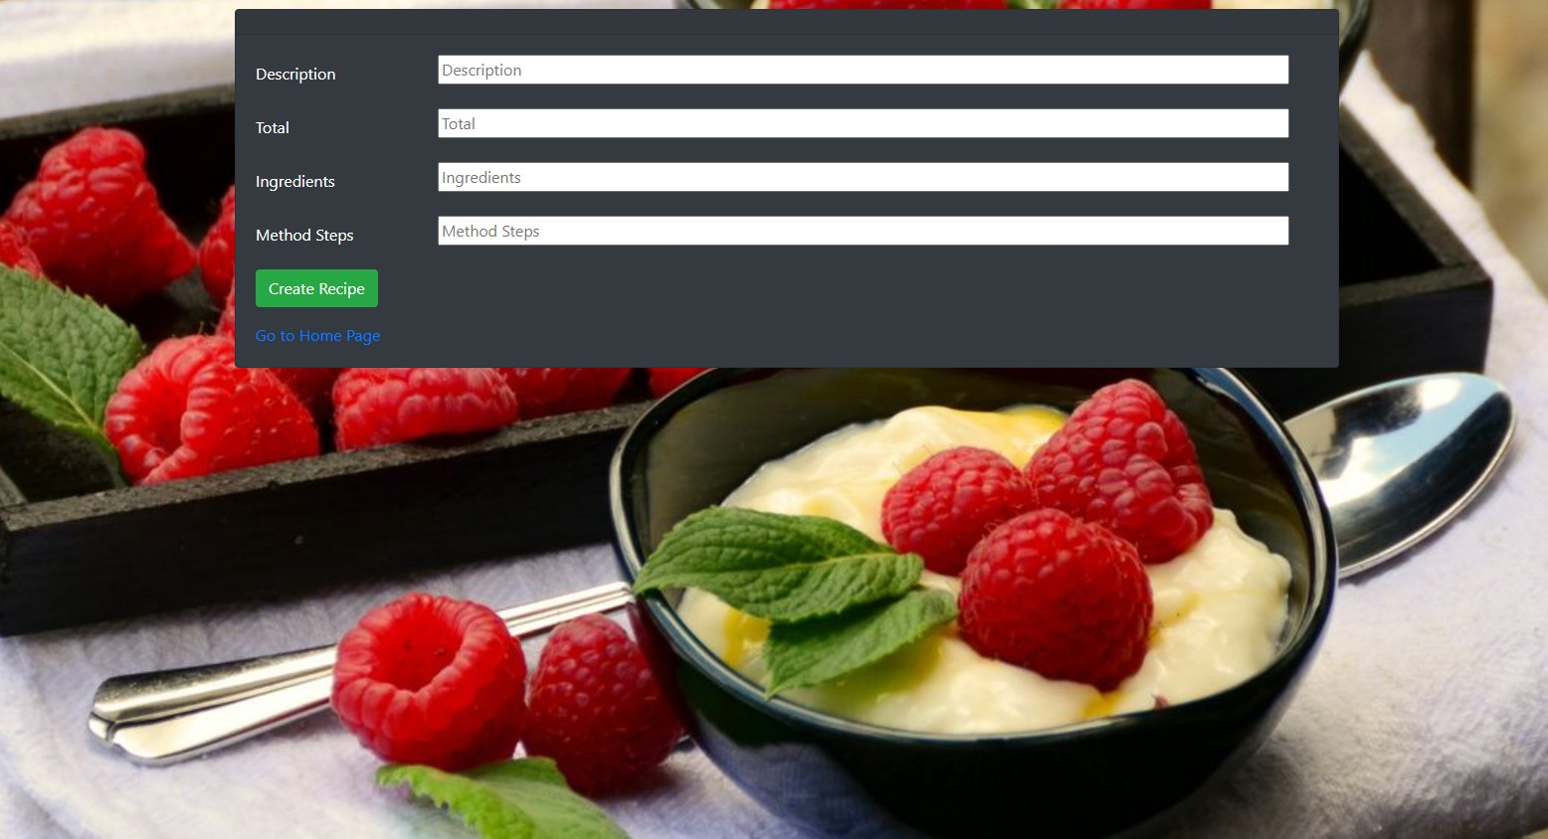

Create a new recipe with joy
GO TO HOME PAGE
CREATE RECIPE
Created by Plamena Petkova
Notes:
The user is able also to create or add a new recipe which automatically will be stored in the H2 database.

Slide 6
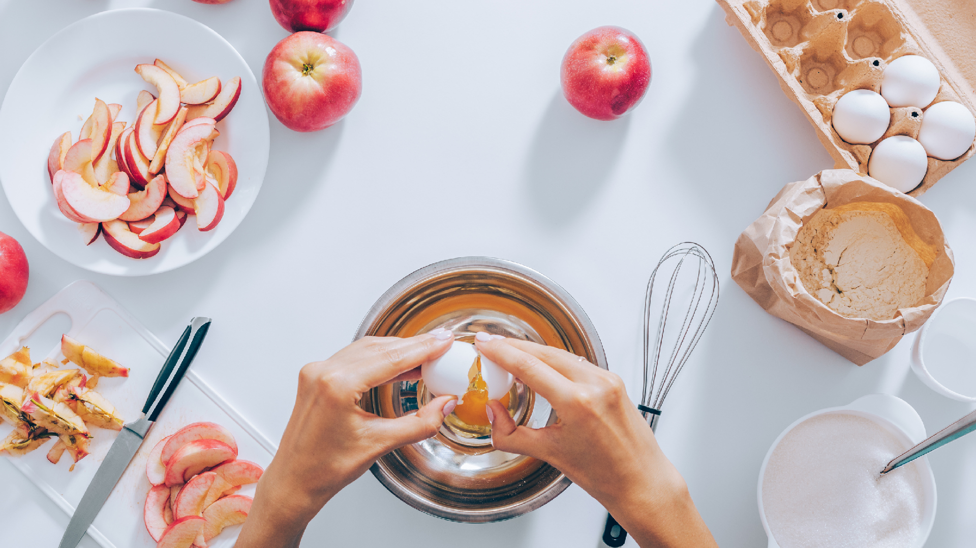
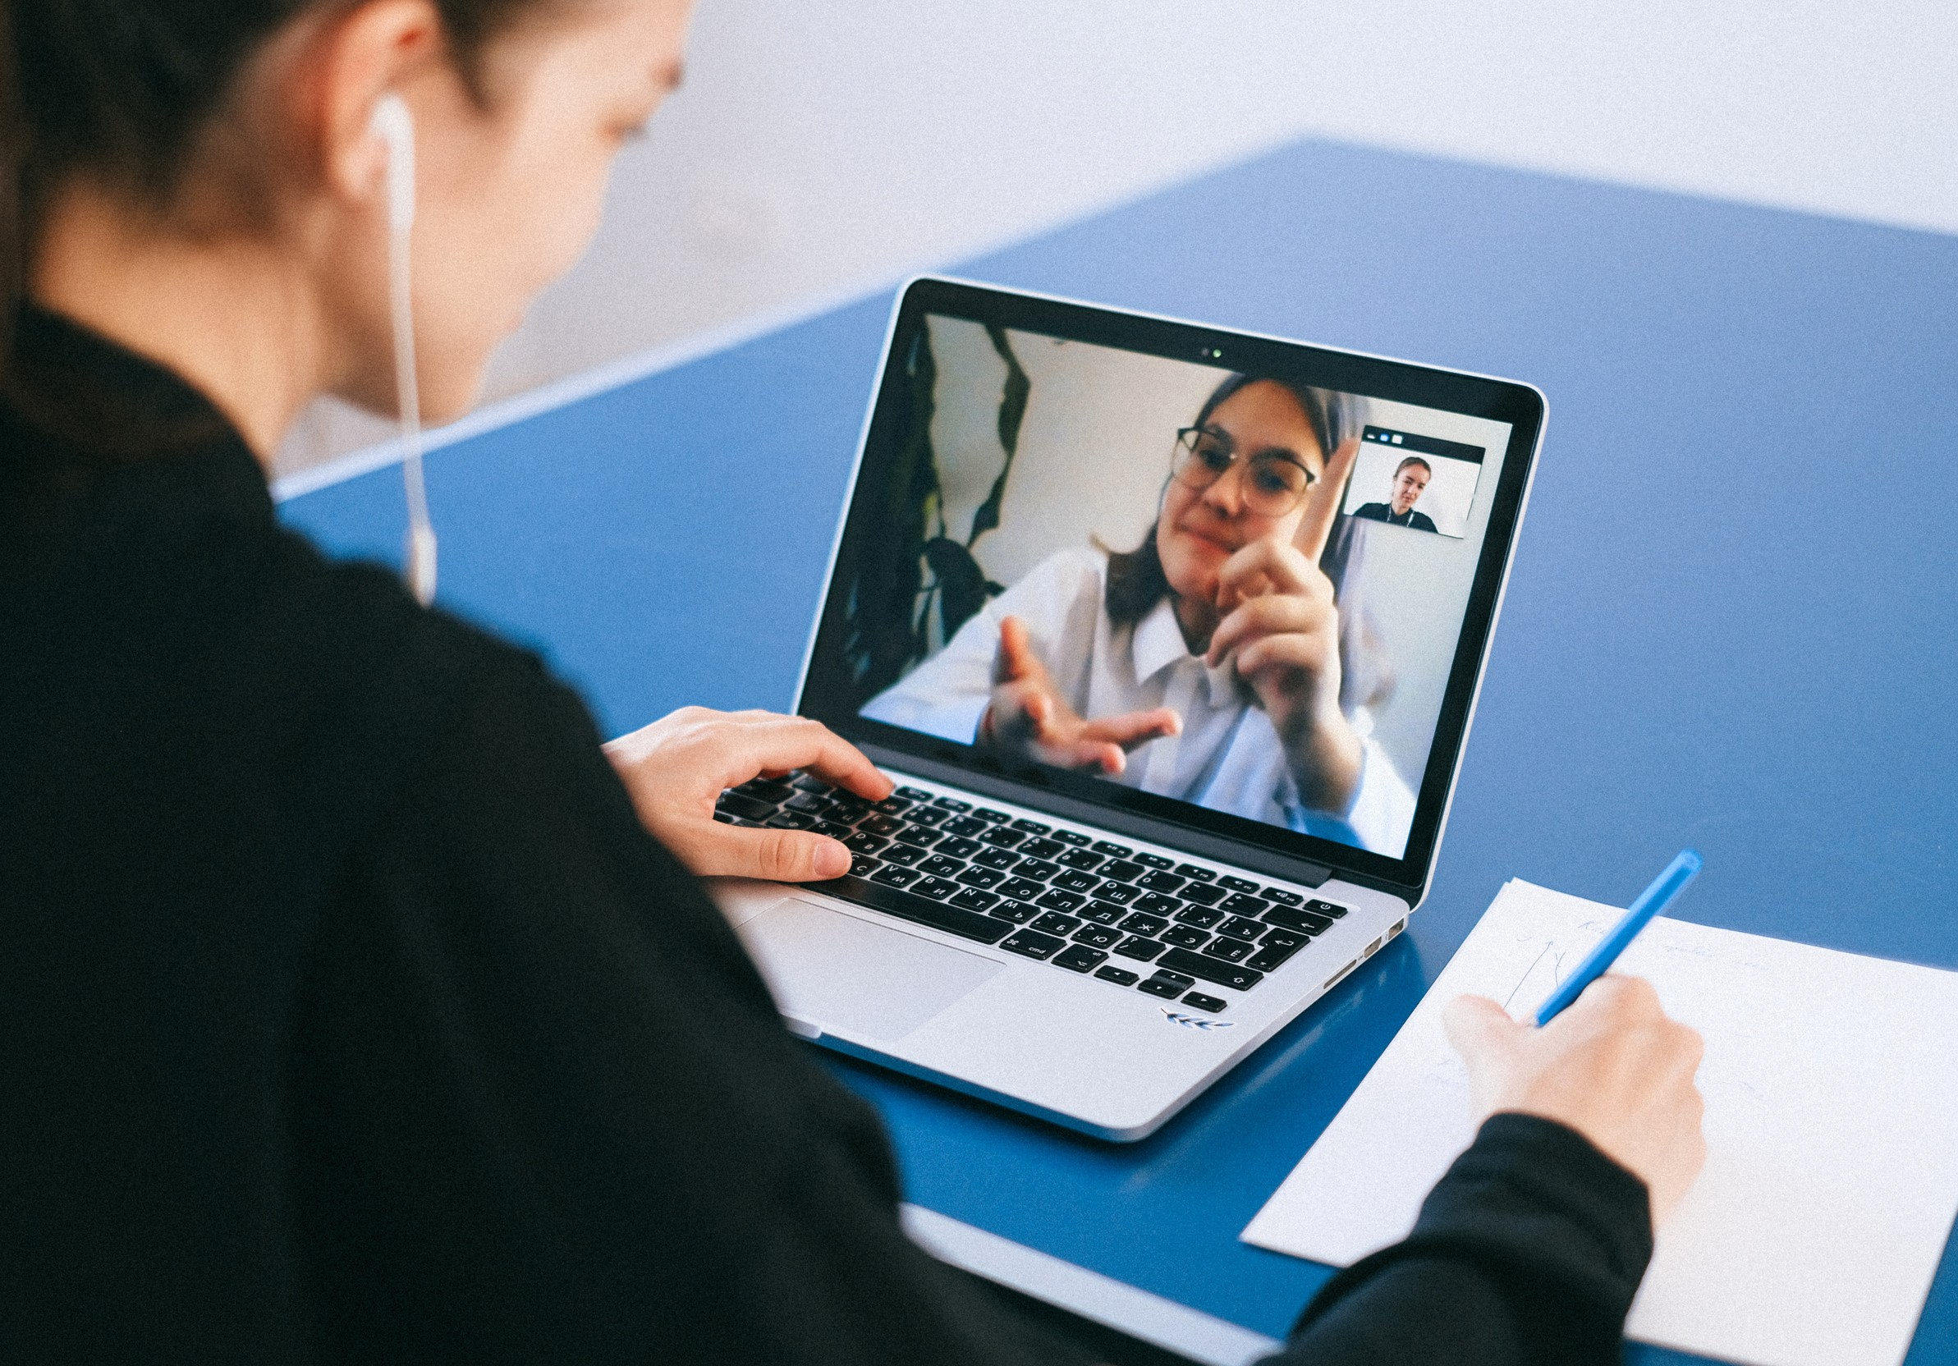



Slide 7
Thank you all
for your time...
AND...

Slide 8
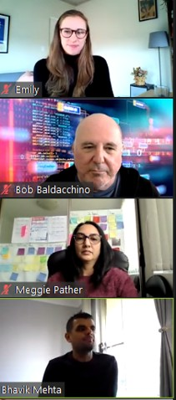
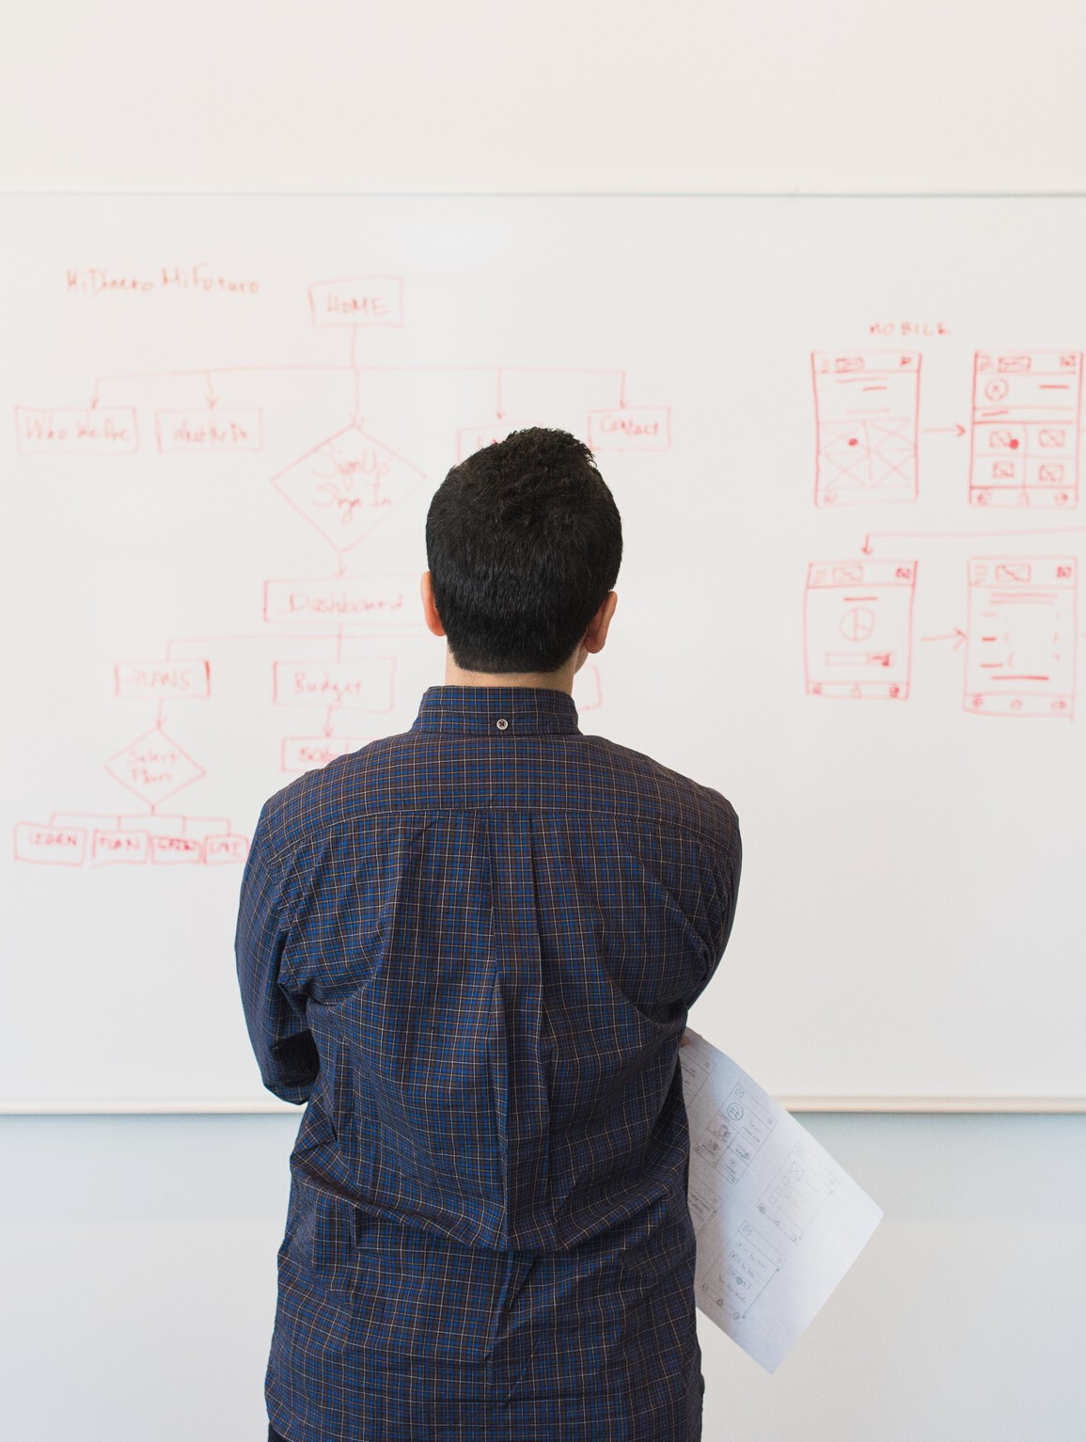
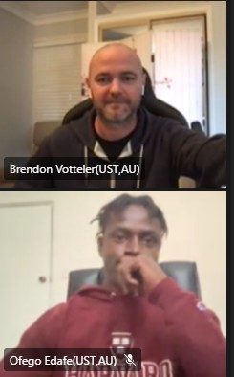

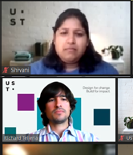
For your support
through this project

